Slide 1
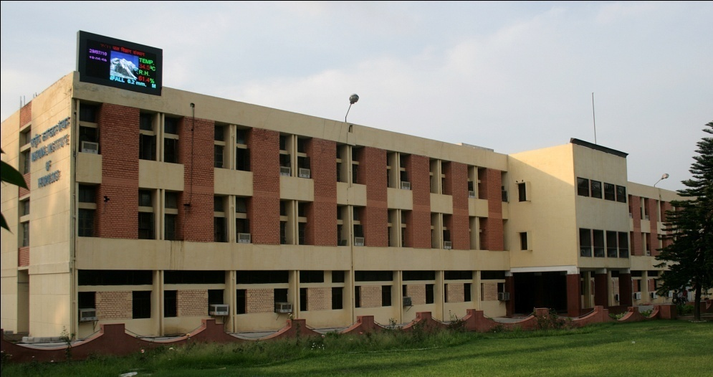
National Hydrology Project (NHP)
NATIONAL INSTITUTE OF HYDROLOGY
ROORKEE

Slide 2
ROLE OF NIH IN NHP
NIH is assigned with the following tasks in NHP:
Planning and organising training programmes for capacity building of the Implementing Agencies (IAs).
Purpose Driven Support (PDS): Initiation, Review and Monitoring.
Centre of Excellence in Hydrological Modelling

Slide 3
Project Management Unit (PMU) at NIH
Dr. Sharad K Jain, Director Project Coordinator
Dr. Sanjay K Jain, Sc. ’G’ Nodal Officer
Er. C P Kumar, Sc. ‘G’ PDS Coordinator
Dr. A K Lohani, Sc. ’G’ Training Coordinator
R&D Section Dr. Anupma Sharma, Sc. ‘D’, Dr. M K Sharma, Sc. ‘D’, Dr. R Thayyen, Sc. ‘D’, Mr. P K Agarwal Sc. ‘B’, Mr. Naresh Kumar, Sc. ‘B’
Training Section: Dr. Sumant Kumar, Sc. ‘C’, Dr. L N Thakural Sc. ‘C’, Dr. Ashwini Ranade Sc. ‘C’, Mr. Prabhash Mishra Sc. ‘B’, and Dr. Gopal Krishna, Mr. Manoj K Goel
Center for Excellence in Hydrological Modelling Dr N C Ghosh, Sc. ‘G’, Dr Anupma Sharma, Sc. ’D’
M&E Section Mrs. Deepa Chalisgaonkar Sc. ‘F’, Mrs. Suman Gurjar Sc. ‘C’
Procurement Section Dr. Surjeet Singh Sc. ’D’, Mr. Manish Nema, Sc. ’C’
Finance Section Mr. S S Lamba, Finance Officer, Mr. Rajneesh Goel, Section Officer

Slide 4
FUNDS RECEIVED AND EXPENDITURE
Fund received 2016-17 : Rs. 2,88,80,000
Expenditure : Rs. 1,00,82,399
Fund received 2017-18 : Rs. 3,14,00,000
Expenditure : Rs. 10,46,411

Slide 5
MAJOR PROCUREMENT
2016-17 and 2017-18
The procumbent of equipments were proposed under annual work plan and approved under component A for the year 2016-17 and 2017-18. For the year 2016-17 the equipments were proposed for three labs. (no list was provided), while for the year 2017-2018, the list and cost of the approved equipments for three labs of NIH are given in the table below.
Total budget for the year 2016-17 and 2017-18 is Rs. 4.2 crore. The revised budget for the two years is same i.e. Rs. 4.2 Crore.
Equipments Approved (2017-18) | Total Budget (Crore) | Revised Equipments to be Approved | Total Budget (Crore)
HYDROLOGICAL INVESTIGATION (HI) LAB Dual Carbon C13 Isotope analyser | 1.0 | Element Analyser (CNS) Tritium Enrichment Unit Normal Scintillation Counter Liquid Nitrogen Plant | 0.50 0.50 0.20 0.20

Slide 6
MAJOR PROCUREMENT
2016-17 and 2017-18
Equipments Approved | Total Budget (Crore) | Revised Equipments to be Approved | Total Budget (Crore)
SOIL WATER LAB. Ion Chromatograph with auto sampler and necessary accessories, CHNS analyzer with biomass converter, Millipore water system (ultrapure), Air Pycnometer, Microwave digester, Tension Infiltrometer : 6 nos | 1.00 | Same, no change | 1.0
WQ LAB. Gas Chromatograph Mass Spectrophotometer GCMS | 0.70 | GC-MS Dedicated Auto Titrator TOC Analyzer | 1.00 0.40 0.40
For HI, WQ and Soil Water Lab. for the year 2016-17 | 1.50

Slide 7
NIH Nodal Agency for training needs
Training needs analysis
Formation of expert committee for
Preparation of training calendar
Identification of training institutes
Course contents and modules
Oragnisation of training courses as per training calendar

Slide 8
Training/Workshops organised
Total 39 training and workshops have been oragnised under NHP since 2015. Out of which some of the courses have been organised by NIH.
NIH has oragnised training courses on i. Basics of Hydrology, Ground water hydrology, HEC based modelling solutions, Hydrologic forecasting etc. Beside this, some of the courses have been organised jointly with CWC and CWPRS.
Some times, it is difficult to get sufficient number of participants for the training course.

Slide 9
PURPOSE DRIVEN STUDIES (PDS)
One of the main focus of NHP is to take up R&D studies in the form of Purpose driven studies (PDS).
PDS would address the specific issues of water management problems identified within the area of operation of implementing agencies and of public concern.
Outcome of the studies are expected to provide feasible and cost effective methodologies for replication in other areas situated in similar hydrological and hydro-geological setup.
To
Total PDS received 30
Presented during first R&D Session (13-14 July, 2017) 26
Sent for approval/revision : 20

Slide 10
PFMS: Public Financial Management System
National Institute of Hydrology, Roorkee is already registered on PFMS.
The Bank Account No. 35527112389 (NHP) is linked to the PFMS.
Soon NIH PFMS account will be operational.

Slide 11
WAY FORWARD
Oragnisation of trainings as per the training calendar and as per the need/requirements of the IAs
R&D session of the PDS received from IAs
Preparation of bid documents of all the equipments
Studies to be carried out in the Centre of Excellence of modeling

Slide 12
THANKS

